Slide 1

Kownoldge and Data Integration
2023.11.15

Slide 2
Team Members and Distribution
Refined Context
Content
Formalized Refined Purpose
Resource Selection
EG file metadata
ER
FT-ETG-EG
Ontology

Slide 3
Team Members and Distribution
First Part

Slide 4
Team Members and Distribution
Heming Yu
Project Manager
(1) Be responsible for the overall situation of the whole project
(2) Coordinate the cooperation and communication among personnel
(3) Actively promote the steady progress of the project, complete the formulated plan on schedule
(4) Ensure that the project can achieve the expected effect in the end
+Jianqiao Chen
Knowledge Engineer
(1) His research direction is how to build a good knowledge map
(2) Fully analyze and utilize the collected data
(3) Reasonably match and build
(4) Establish a relatively complete and reasonable knowledge map
+ An Wang
Data Scientist
(1) Mainly responsible for sorting, classifying and storing the collected data
(2) Discuss the specific algorithm of data processing with domain expert and implement it with code
(3) Discuss with knowledge engineer how to build the knowledge map and implement it in code
(4) Ensure that the final data and code of the project can be completely implemented

Slide 5
Refined Context
Second Part

Slide 6
Refined Context
Domain of interest
Recommendations for winner of League of Legends S13 World Championship
Personas
Audiences
Scenarios
For a game of S13 World Championship, the winner is recommended to audiences based on team comprehensive strength.

Slide 7
Formalized Refined Purpose
Third Part

Slide 8
Formalized Refined Purpose
Raw Competency Questions
CQ1: Who is the winner of the two teams in League of Legends S13 World Championship competition?
CQ2: List all teams with its performance,historical records.
CQ3: List all players with their performance related to the team.
CQ4: List all competition with reward rate.

Slide 9
Formalized Refined Purpose
Kernel Competency Questions
CQ1: winner, teams, League of Legends S13 World Championship
CQ2: teams, performance, historical records
CQ3: players, performance, team
CQ4: competition,reward rate

Slide 10
Formalized Refined Purpose
Analyzed Competency Questions
CQ1:
Common: teams，competition
Core: winner
Contextual: League of Legends S13 World Championship
CQ2:
Common: teams
Core: performance,records
Contextual:historical
CQ3:
Common: players
Core: performance
Contextual: team
CQ4:
Common: competition
Core: reward rate
Contextual:

Slide 11
Formalized Refined Purpose
Classified Competency Questions
CQ1:
Common: Objects: Person, Winner
Core: Functions: teams
Contextual: Function: League of Legends S13 World Championship
CQ2:
Common: Objects: teams
Core: Functions: performance, records
Contextual: Function: historical
CQ3:
Common: Objects: Players
Core: Functions: performance
Contextual: Function: team
CQ4:
Common: Objects: competition
Core: Functions: rate
Contextual: Function: reward

Slide 12
Attributed Competency Questions
Object | Components
Team | Team_ID, TeamName, NationalRank, TeamValue, AverageAge
Team_Performance | Team_ID,TeamName,TeamNationalRank,TeamKDA,TeamAverageKillPerGame,TeamAverageDeathPerGame,TeamDamagePerMinute,TeamMoneyPerMinute
Team_Historical_Record | Team_ID, TeamName, Event, EventValue, GameResult, GameResult_ID, Date
Player | Player_ID, PlayerName, PlayerPosition, PlayerAge,PlayerValue
Player_Performance | Player_ID,PlayerName,KDA,ParticipationRate,AverageKillPerGame,AverageDeathPerGame,DamagePerMinute,MoneyPerMinute ,AverageAssistsPerGame
Reward_Rate | Team_ID, RedTeam,BlueTeam, RedWinRate, BlueWinRate

Slide 13
Resource Selection
Fourth Part

Slide 14
Resource Selection
Knowledge Resources
Player and teamstatistics Dataset：
Score is an esports celebrity and anchor graphic, voice, and video information app. Focus on top players in the esports industry and get game information as soon as possible.
https://www.scoregg.com/
Play Plus esports is a cutting-edge esports platform that focuses on esports data, culture, business, and innovation. By mining the commercial value of events, teams, and players through data, and deriving a series of appealing brands.
https://www.wanplus.cn/
Reward rate information Dataset：
As the largest anime video platform in China, Station B has more than 300 million monthly active users, many of whom are non core events or potential event users. During the S13 period, it provided reward rates for each team to provide a more unique viewing experience for the audience.
https://www.bilibili.com/online.html

Slide 15
Resource Selection
Data Resources
- Alignment in format
- Sample and scale of the data retrieved
Team Dataset： 10
TeamPerformance Dataset：10
- Problems solved in retrieval
Object | Components
Team | Team_ID, TeamName, NationalRank, TeamValue, AverageAge
Team_Performance | Team_ID,TeamName,TeamNationalRank,TeamKDA,TeamAverageKillPerGame,TeamAverageDeathPerGame,TeamDamagePerMinute,TeamMoneyPerMinute
Player | Player_ID, PlayerName, PlayerPosition, PlayerAge,PlayerValue
Player_Performance | Player_ID,PlayerName,KDA,ParticipationRate,AverageKillPerGame,AverageDeathPerGame,DamagePerMinute,MoneyPerMinute ,AverageAssistsPerGame
Reward_Rate | Team_ID, RedTeam,BlueTeam, RedWinRate, BlueWinRate

Slide 16
EG File Metadata
Fifth Part

Slide 17
EG File Metadata
Explaination of the ER
① Object
Person
Reward rate
② Function
Find the winner of competition.
③ Action
Teams will compete.
④ Property
- Object Property
Team
Reward rate
Team Performance
- Data Property
None

Slide 18
ER
Sixth Part

Slide 19
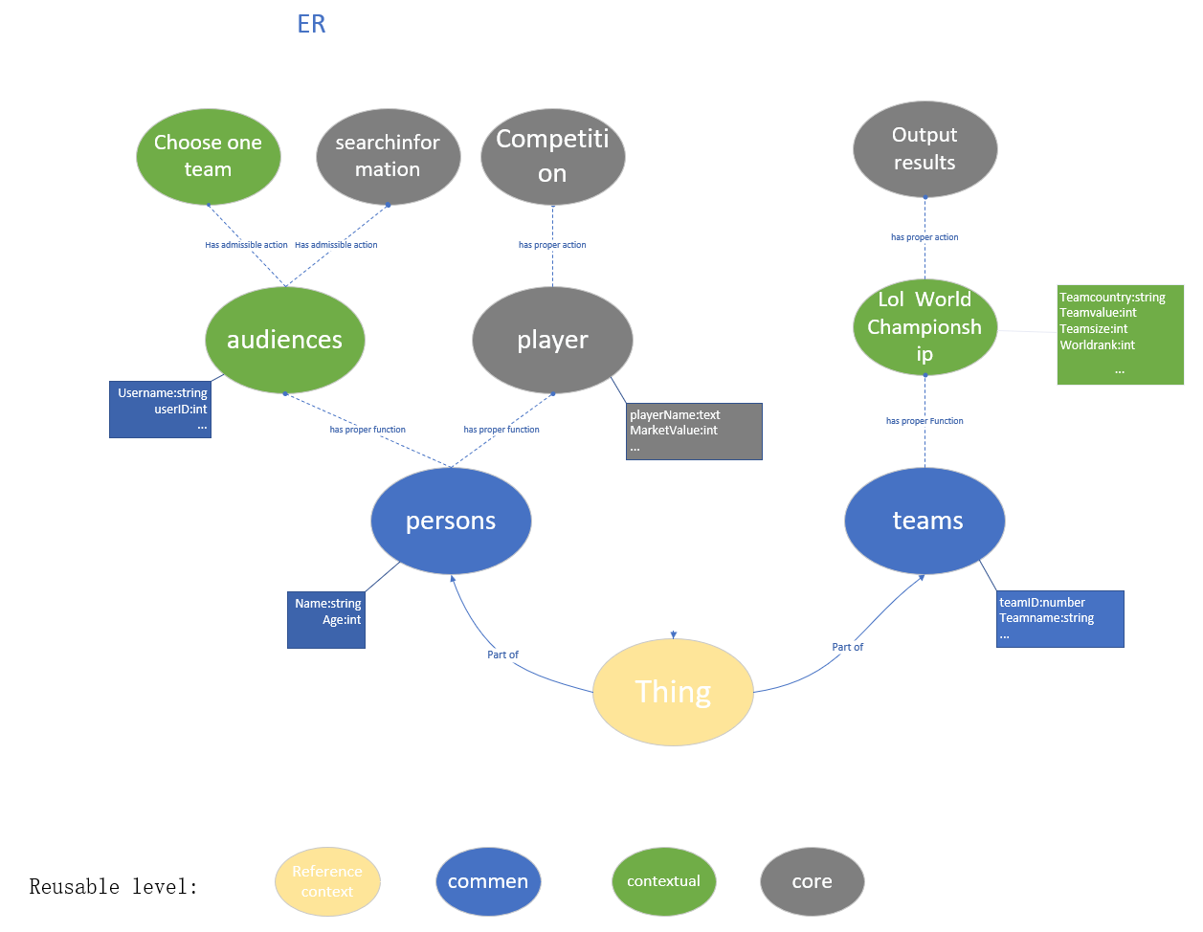
ER

Slide 20
FT-ETG-EG
Seventh Part

Slide 21
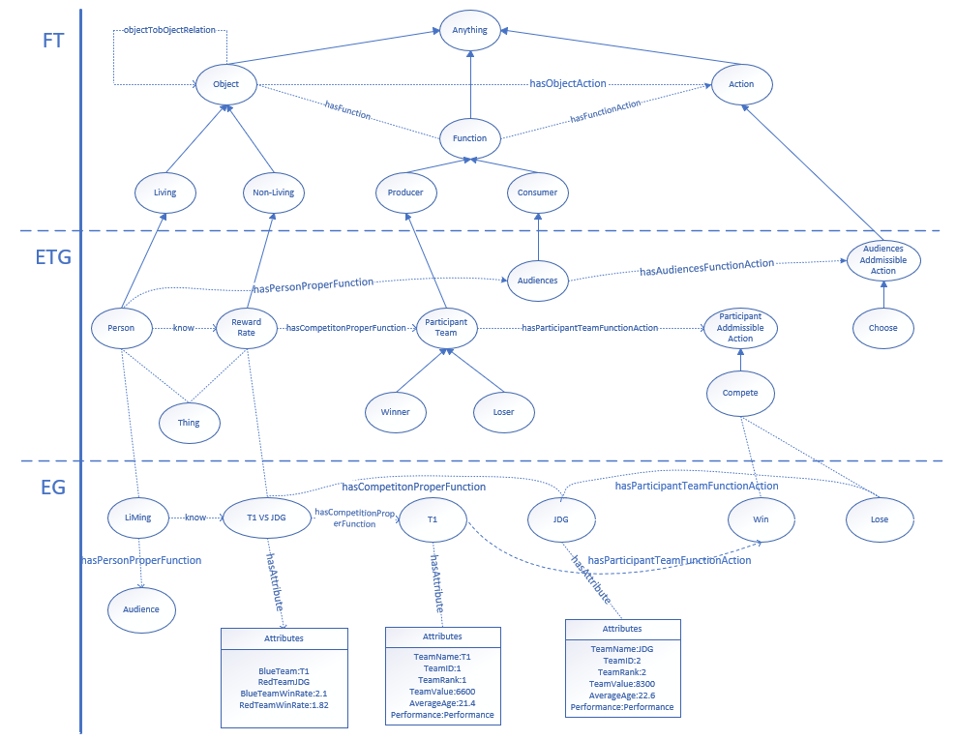
FT-ETG-EG

Slide 22
Ontology
Eighth Part

Slide 23
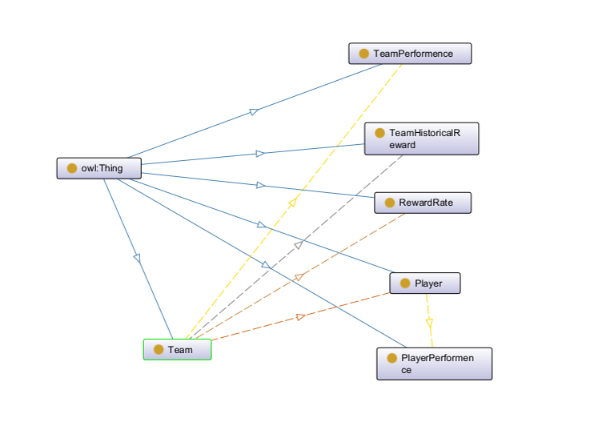
Ontology

Slide 24
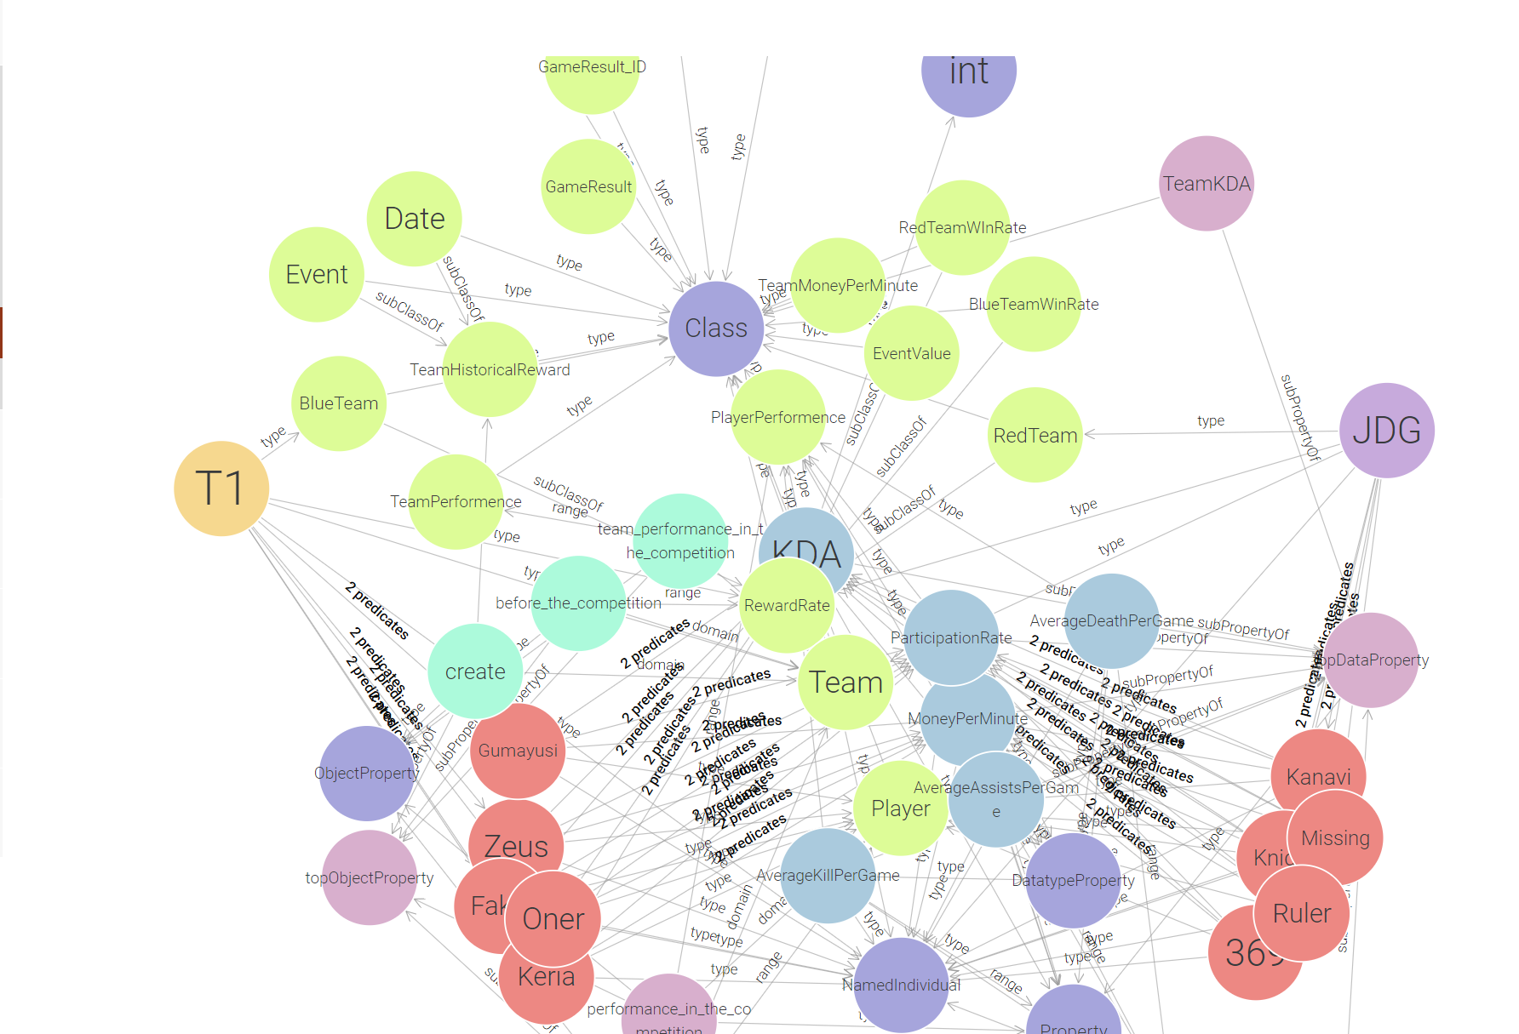
Knowledge Graph

Slide 25
Thanks!

